Slide 1
Button click handlers
Maarten Pennings

Slide 2
Introduction
An activity has one or more views
  view is also known as widget or control
  examples include Button, TextView
The user interacts with these views
  click on them, types in them, drags them
  such an interaction is referred to as event
The event should be handled
  sometimes the build-in code of the view can handle the event
  but typically a piece of application code should run
  this piece is referred to as the event handler

Slide 3
Aim
This presentation shows
  how to attach an event handler to a view
  unfortunately, several approaches are possible
  contributing to the confusion
  hence this presentation
Three approaches are shown
  statically couple handler in xml
  dynamically couple handling object in java
    four variants will be shown: activity, anonymous, var, class
  override default handler in subclass

Slide 4
Option 1
On click in XML

Slide 5
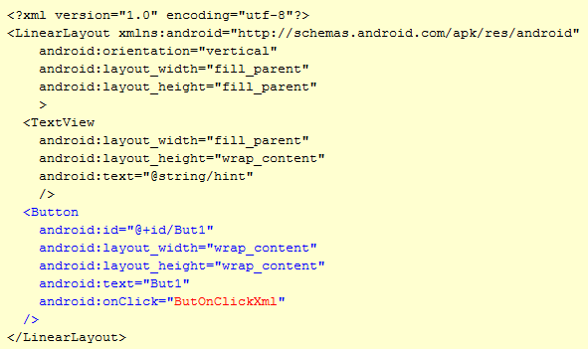
Opt 1: on click in xml - xml
Note the static coupling of the event (onClick) to its handler (ButOnClickXml).

Slide 6
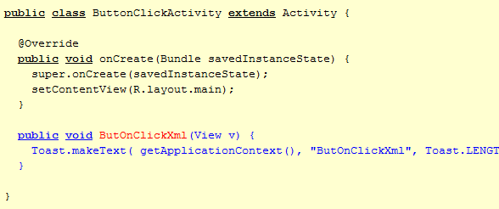
Opt 1: on click in xml - java
The application level handling code is in java (here just a toast).

Slide 7
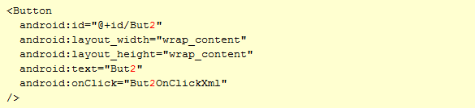

Opt 1: on click in xml – But2
It is easy to add a second button with its own handler.

Slide 8
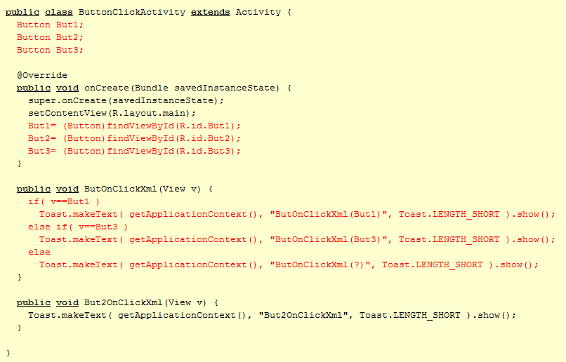
Opt 1: on click in xml – But3
It is easy to add a third button that shares its handler with the first button.
The handler can even check which view was the source of the click.

Slide 9
Opt 1: on click in xml
Concise
Multiple buttons can each have own handler
Multiple buttons can share handler
But, there is no setOnClick() in Java
  So can not be used for dynamically created buttons
“on click” is the only supported event in xml
  So can not be used for e.g. on touch event

Slide 10
Option 2
Listener objects

Slide 11
Listener objects
Option 1 is “delegation pattern”
  Button has mOnClick field (can only be set in xml)
  It stores a callback method: object pointer and function pointer
  Button calls the method upon click
Option 2 is “listener pattern” (more adhering to OO style)
  Button has mOnClickListener field (can only be set in Java)
  It stores a callback interface: pointer to object
  Object is called the listener
  Object can be any (class) type
  But object must implement OnClickListener interface
  This interface has only one function: onClick
  Button calls onClick on object upon click

Slide 12
Listener interface
Any widget (any class derived from View)
has a field
OnClickListener onClickListener;
interface OnClickListener
{
abstract void onClick( View v );
}

Slide 13
Option 2a
Activity is listener

Slide 14
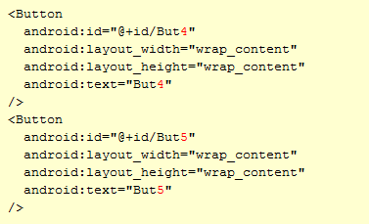
Opt 2a: activity is listener - xml
There is no
onClickListener
in xml …

Slide 15
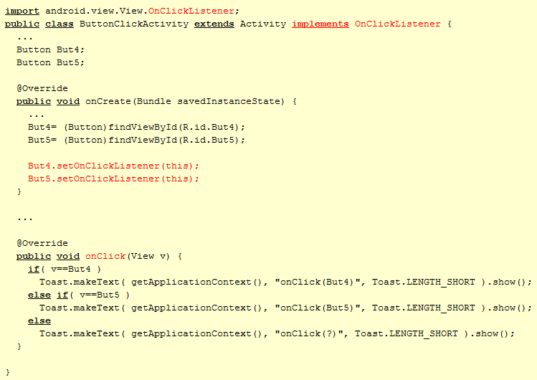
Opt 2a: activity is listener - Java
… but there is a
setOnClickListener()
in Java
Note that activity claims to implement and implements OnClickListener interface (i.e. onView function)

Slide 16
Opt 2a: activity is listener
Scattered (xml, onCreate, onClick)
The Activity’s onClick must handle all buttons
  Ugly if-then-else chaining
Some callback interfaces have multiple functions
  All must be implemented (stubbed)
If onClick in xml and setOnClickListener in Java are both used, then onClick is ignored
Can not call multiple setOnClickListener as in C#

Slide 17
Option 2b
Inline listener

Slide 18
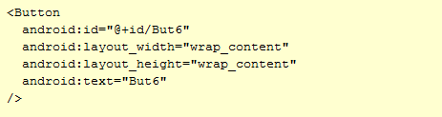
Opt 2b: inline listener - xml
Same as 2a
(set listener in Java)

Slide 19
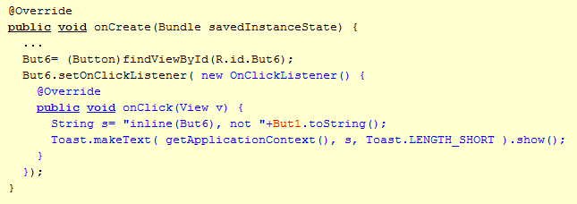
Opt 2b: inline listener - Java
Lookup But6, and set its listener object.
It is created inline, with override of onClick.
It may use any field (But1) of the activity.

Slide 20
Opt 2b: inline listener
Less scattered (xml, onCreate), but lot in onCreate
Each button has own handler
Buttons can not share handler (but see 2c)
Extra listener object created (memory issue?)
Still: callback interfaces may have multiple functions

Slide 21
Option 2c
Listener in variable

Slide 22
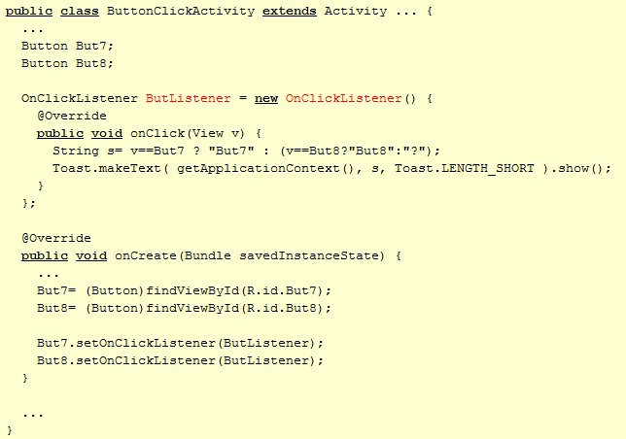
Opt 2c: listener in variable - Java
I guess that creating an interface is syntactic sugar for creating an empty object.
Inlined listener stored in a variable, and used for two buttons

Slide 23
Opt 2c: listener in variable
More scattered (xml, onCreate, var)
Each button can have own handler
Buttons can share handler
Still: extra listener object created (memory issue?)
Still: callback interfaces may have multiple functions

Slide 24
Option 2d
Listener class

Slide 25
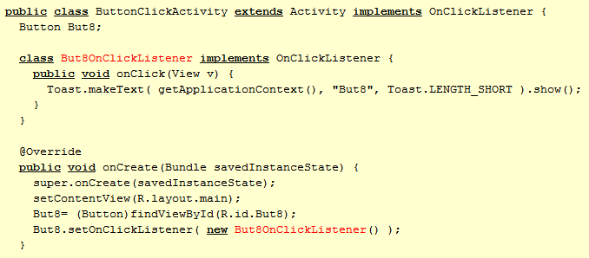
Opt 2d: listener class - Java
Class explicit (But8OnClickListener) …
… but object anonymous
(new But8OnClickListener)

Slide 26
Opt 2d: listener class
Makes no sense
  Why define class if only one instance is needed

Slide 27
Option 3
Subclass button

Slide 28
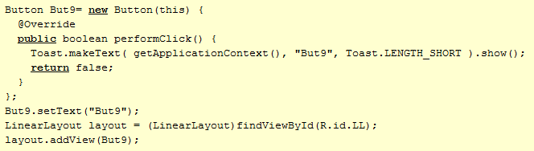
Opt 3: Subclass button
Dynamic creation of But9
(view not declared in xml but in new’ed in Java).
Class for But9 has inline extension,
overriding the performClick().

Slide 29
Opt 3: Subclass button
Does not seem wise…

Slide 30
Summary
Option
Verdict
1) on click in XML
Looks best, but only works for “on click”
2a) activity is listener
Clumsy: all click are funneled to single handler (if-the-else chain)
2b) inline listener
Clumsy: all click handlers in onCreate (which gets too large)
2c) listener in variable
Separate handlers, sharing (but: no xml, extra obj, multi func)
2d) listener class
Nobody does this
3) subclass button
Nobody does this

