Slide 1
Inline class extend
Maarten Pennings

Slide 2
Button click
What does this (the red part) mean?

Slide 3
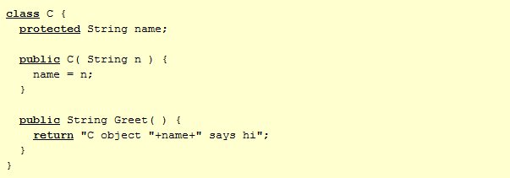
Class instantiation

Slide 4
Class extension

Slide 5
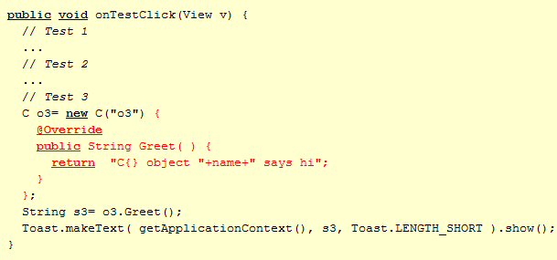
Inline extension – override only
Implicit sub-class
Anonymous class
Inlined class

Slide 6
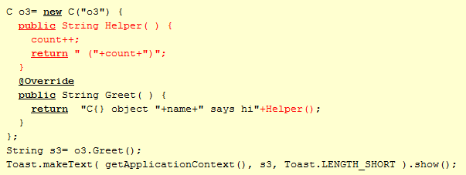
Inline extension – adding a method

Slide 7
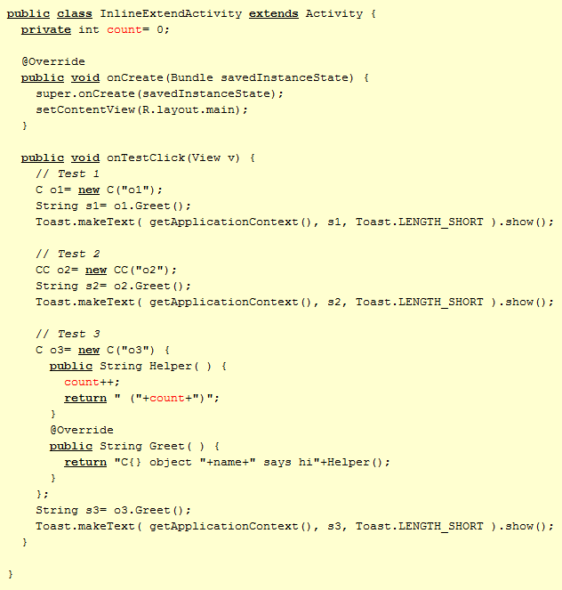
Inline extension – scope
An inner class has an extra member (this$0) which links an object of the inner class to an object of the outer class.

